Slide 1
The Impact of Child Health and Nutrition on Education in Less Developed Countries
Paul Glewwe and Edward Miguel
Presented by: Danielle hata

Slide 2
Introduction
Children in LDCs have poor health and nutrition as well as fewer years of schooling and learn less per year of schooling than children in developed countries.
Poor health and nutrition reduces time in school for children.
Increasing children’s health would improve the efficiency of education and would hopefully improve quality of life.
Data is scarce, and there is often bias.
This article
  Basic facts about child health and education
  A framework for analyzing the impact of health and nutrition on education
  Estimation problems with solutions and empirical evidence

Slide 3
Basic facts
1/3 of children below the age of 5 experience growth stunting relative to international averages
Worse health and education in LDCs is a symptom of lower income and lower quality and less accessible healthcare and education systems.
Not much data that is comparable across multiple countries
  Height and weight, and mortality rates are most available

Slide 4
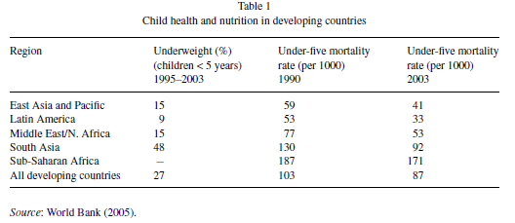
Weight and Mortality
27% of children in LDCs are underweight (9% in Latin America and 48% n South Asia)
10.3% of children in LDCs died before the age of 5 (2000)
  Fell only to 8.7% in 2003
Latin America 3.3%, South Asia 9.2%, Sub-Saharan Africa 17.1%

Slide 5
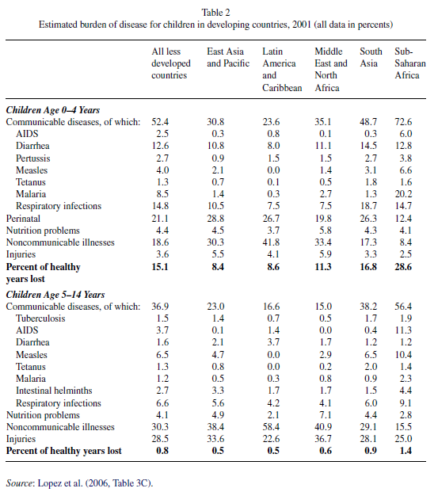
Burden of disease
Given certain diseases, there was a World Bank study that calculates the estimated percent of healthy years lost to children.
Most loss is due to communicable diseases, top 4 are respiratory infections, diarrhea, malaria, and measles.
20% of the burden of disease comes from perinatal problems
While there is large variation across each geographic region, most notable is that AIDS and malaria play a small role except for in Sub Saharan Africa

Slide 6
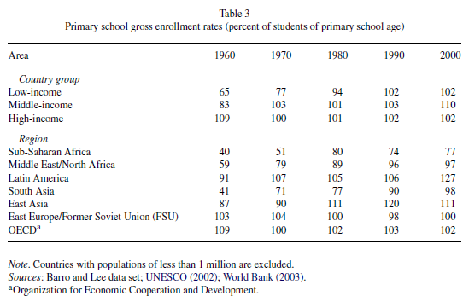
Education (Gross Enrollment Rates)
Table of gross enrollment rates, grouping countries by income and also by region.
GER = number of children enrolled in a level of education/population in the age range associated with that level.
2000 – GER was higher than 100% in all income ranges, and all regions except Sub-Saharan Africa (actually declined)
GER>100 does not mean that all children are in school, but that there is over reporting and grade repetition (not in age group, but still in school)

Slide 7
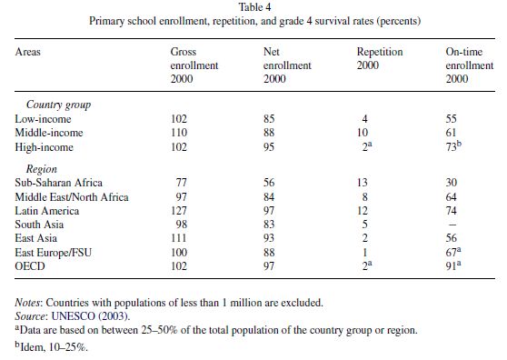
Education (Net Enrollment Rates)
NER = number of children enrolled in a level of schooling who are of the age associated with that level/all children of the age associated with that level of schooling.
Removes the upward bias of GER, but there is still over reporting.
Secondary school enrollment(not pictured):
Enrollment has slowed.
2000 GER – Sub-Saharan Africa(27%), Middle East/North Africa(66%), Latin America(86%), South Asia(47%), East Asia(67%), East Europe(88%).

Slide 8
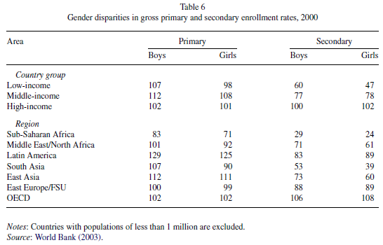
Education (Gender Disparity)
Across all incomes, there is a gap between female and male enrollment, that decreases as income increases.
Gap is larger in secondary schooling than primary.
Latin America, East Asia, East Europe, OECD – low gap at primary level.
East Asia – large gap at secondary level.
Sub-Saharan Africa and Middle East/North Africa, gap is large at primary AND secondary
Largest gaps is in South Asia

Slide 9
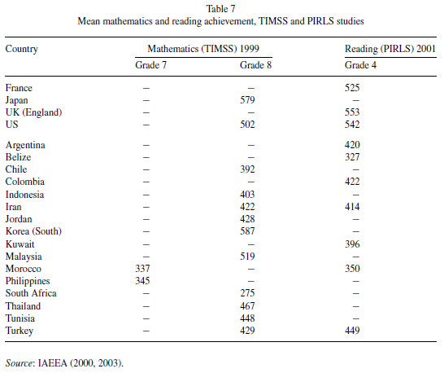
Education (Quality)
Comparing Math and Science test scores with Reading scores.
US, Japan, South Korea, and Malaysia have high math scores, while South Africa has the lowest.
Across the board, the LDCs have lower reading scores than the developed countries (France, UK, US)
  Students are likely to miss the test

Slide 10

The Analytical Framework
2 period model of child health and schooling outcomes
Period 1 is conception – 5-6 years old
Period 2 is primary school age 6-11 years old
(1)
T2 = test scores in primary (production fct)
Ht = child health in period t
Eit = parents’ educational inputs
α = child’s innate intelligence
SC = school characteristics
YS = years of schooling
Structural relationship between each variable and the academic skills.
All directly affect test scores.
Parents’ utility function
(2)
Ct = parental consumption
All variables have positive effect, ignores future consumption
Leisure is fixed.

Slide 11


Cont.
Utility maximized st the budget constraints (3) (4)
Cct = the child’s consumption
Mt = health inputs
HEt = local health environment
n = innate healthiness of child
Parents cannot control HE or n.
Indirect effects are excluded.
Intertemporal budget constraint:
(5)
Pct = price of the consumption good
Pmt = price of medicine (in terms of forgone wages)
EIt = educational inputs purchased by parents
PEI = price of educational inputs (const over time)
Ps = price of a year of schooling

Slide 12
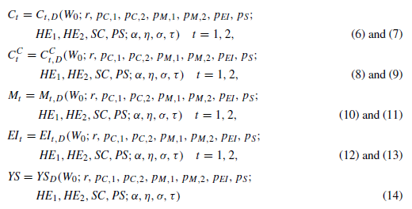

Optimizing
9 endogenous variables
PS = parents’ schooling
σ = parental tastes for child education
τ = parental tastes for child health
RHS variables are all exogenous
Demand for child’s academic skills
(15)

Slide 13
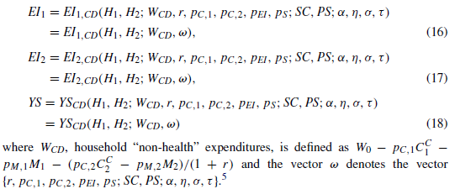
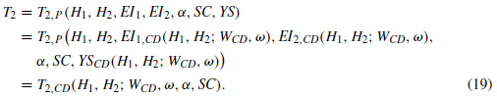

Conditional Demand Function
Fix child consumption and health inputs (health is now fixed)
When child health in both time periods is fixed at their utility maximizing levels, small changes in heath affects parents choice of T2.
You can use EQ (19) to observe the indirect and direct effects of changes in any of the RHS variables, but the sign of the net effect is usually ambiguous due to conflicting income and substitution effects and the complex interactions of variables.

Slide 14
Relationships of Interest
Factors that determine children’s academic skills (1)
Measure direct impact of variables that have direct impacts on academic skills in time 2.
Helpful, but does not imply that improving health conditions will improve education because demand for education inputs and years of schooling may also change.
Parents may change their demand of child’s academic skills.
Demand for child’s academic skills equation (15)
Changes in health environment or prices of health inputs lead to changes in the demand for child’s academic skills.
This equation is better to assesss the impact of health policies as opposed to health status on children’s academic skills.
Important to remember to distinguish between changes in t1 and t2, ie long run and short run.

Slide 15
Relationships of Interest
Conditional demand relationship (19)
Useful for assessing how shocks to health in either time period can affect academic skills before adjusting for long term.
Accounts for sum, but not all behavioral choices.
  Excluding child consumption and purchases of health inputs in both time periods.
Summary
Important to clarify what relationship you are estimating, and whether impact is long run or short run
Differences in studies may be different relationships, or long-run vs short-run effects

Slide 16
Estimation Strategies: Problems and possible solutions
What can be done to estimate the relationship between child health and education with the three main types of data:
  Cross sectional (collected from the “real world” at one point in time)
  Panel data ( collected from households at several points in time)
  Random evaluations (collected from an experiment in which one or more groups is randomly selected to receive treatment, while others serve as control)
Cross Sectional Data
  To avoid omitted variable bias, you need measures of all explanatory variables in the equations
  H1, H2, EI1, EI2, innate intellectual ability, school and teacher characteristics, and years of schooling
  To find H and EI, you must ask, which leads to recall errors.
  Teacher and school characteristics are very hard to measure or even define.
  Cross sectional data will be incomplete and have omitted variable bias

Slide 17
Cross Sectional Data (cont.)
Random measurement errors in the explanatory variables
  Can lead to underestimation of the impact of variables on education outcomes (attenuation bias)
  Asking people about past health status and parental education inputs are likely to be erroneous
  Estimates based on them are likely going to be biased.
  Current health can even be measured with error
  Some variables, parental tastes, innate healthiness and intellect, are hard to measure in the first place.
  EQ (15) may be the easiest to measure variables for, but health environment is difficult
Solution
  Use Instrumental variables to overcome bias
  Very hard to find good IVs.
  If there is no measure for H1, but H2 exists, you need to find a variable that predicts H2 but is not correlated with H1. ie HEt, Pmt in EQ (19)

Slide 18
Panel Data
Benefits:
  Need measurements from the same child for more than one time period. All 3 main EQ in this paper use 2 periods (1) (15) (19).
  Less likely to have recall bias, since you visit the same child twice.
  Can leave out unobserved variables that will not change over time (intellectual ability, innate healthiness, parental tastes, school quality).
  Variables that do change over time are easier to observe, so there is less omitted variable bias.
Limitations:
  Assumes that unobserved variables do not change over time and do not interact with ones that do.
  If they do, then it will lead to bias
  Measurement errors in observed variables will have greater biases given that fewer variables are measured.
  Panel data is more expensive to collect, not to mention moving respondents (same point in the last paper)

Slide 19
Randomized Evaluations
Description:
  Divide a population into two groups, one which will participate in the program (treatment group) and one who will not (control group)
  Can have several treatment groups, and results are quite credible to policymakers.
  Differences between the treatment and control are completely uncorrelated with the explanatory variables because the groups are created by random assignment.
Limitations:
  Cannot violate regulations on human subjects research ie cannot prevent people from being treated when others are treated.
  Random assignment is not usually actually randomly assigned.
  If people leave during treatment, there can be bias, even more bias if the treatment is the cause of leaving.
  Can only measure net effects, not partial or direct effects
  Can be long lag time between start of intervention and evaluation of impact

Slide 20
Empirical evidence (Cross Section)
Glewwe and Jacoby (1995) – impact of child nutrition on age of school enrollment and years of completed schooling using cross sectional data from Ghana
Investigate delayed enrollment and final grade attainment
Child height for age as indicator of health
Parental tastes for child health and education may be positively correlated.
Family fixed effects – examine variation within families not across families (tastes will be constant).
  Innate healthiness or random shocks can cause reallocation of education resources. Sickly child does poorly, so family will compensate or neglect that child’s education.
Instrumental approach – Distance to medical facilities(type of health input price) and maternal height (reflects child’s innate healthiness). Only works across households.
  Mother’s height would influence MPN, thus income, and EI. Distance to medical facility can influence school quality.

Slide 21
Panel Data
Alderman et al. (2001) – Panel data collected from 1986 to 1991 for 800 households in rural Pakistan.
Food prices in t1 as IV for child health status.
  Avoid biased estimates of parental tastes and child’s innate ability and health
Measured that health through height for ages at age 5 has significant positive effect on probability of being enrolled in school at age 7.
Estimate a conditional demand function (19).
Price shocks as IV is only valid if there is an initial wealth variable that excludes spending on child health.
Food prices would affect child health and adult consumption, as well as household savings and education choices in t2.
  Bias towards overestimation.
Probable error in household wealth reporting -> bias of estimates of all impacts.

Slide 22

More Panel Data
Glewwe, Jacoby, and King (2001) – Panel data, 2000 households, Philippines.
Estimates academic skills through test scores, similar to EQ (1).
Compares siblings, getting rid of school quality differences, but does not remove innate ability differences between siblings, which can affect EI per child, or health investments when young.
Argue that early childhood health investments cannot be correlated with innate ability because the child is too young to observe innate ability.
Also assumes that decisions in t1 have more impact on academic outcomes, EI in t1 and H2 have little effect on academic scores.
Good health leads to fast growth. Difference over siblings in the same school to get rid of SC.
Use differences in age as a IV for estimating ΔYS and height of the oldest child at age 24 mo (innate ability still unknown) as a IV for estimating ΔH1.
  Still unknown if height of older child, at age 24 mo is uncorrelated with ΔEI2. Also argue that EI1 should not be dropped. (Believed to be important in the US)

Slide 23
Randomized Evaluations
Iron deficiency – studies in India and Indonesia found iron supplements had significant impacts on cognitive development and school performance, but another in Thailand found it did not hold.
Intestinal Parasites – studies of drug treatment of whipworms and other parasites have mixed impacts with regards to cognitive development, educational outcomes, and academic performance. Studies were conducted in South Africa and Jamaica.
  Small sample sizes, or combine education interventions with health interventions, so impacts of health intervention are difficult to discern.
Calorie Supplements – study of giving caloric and protein infused food to mothers and young children in Guatemala had large effects 2 decades later on cognitive development.
  Only performed with 4 villages, intervention did not vary within villages. Control group was given a very weak treatment, but it was a treatment. Receipt of treatment was voluntary within the village, so it wasn’t really randomized. Very high sample attrition(1/4).

Slide 24
Summary and Conclusion
There are multiple distinct relationships between child health and nutrition on education outcomes.
3 types of relationships
  Production function for academic skills (1)
  Standard demand functions (15)
  Conditional demand functions (19)
Two fundamental problems
  It’s near impossible to obtain estimates of all of the variables, leading to omitted variable bias.
  There is high measurement error which leads to attenuation bias.
Even with differences in data types, studies find significant positive impacts of child health on education outcomes.
Many researchers are in the process of building better panel datasets.

Slide 25
Summary Cont…
Many of these studies use height as a measure of health, but it’s actually unlikely that the health problems will affect the child’s height.
The authors advocate for international aid organizations to conduct their own large scale randomized evaluations, which would be very difficult.
  It would create a data bank that could be used by many to check biases against.
There’s a lot of room to grow, and there needs to be a lot more data and studies done to find out exactly what policies would lead to better education and long run growth of a country

